Slide 1



6th International Conference on
Inventive Computation Technologies
ICICT 2023
26-28, April 2023 ⟡ Lalitpur, Nepal
Paper ID: ICICT1001
A Novel Method For Colorizing Black-And-White Videos And Images Utilizing
Faster R-CNN
Members:
Sai Santhosh V C
Mohamed Rasik P
Sameer Sheriff SM
Raghav Krishna J
S. Kingsley

Slide 2
OBJECTIVES
To generate a fully colorized image and video from black-and-white source input (CCTV).
The goal is to make the output image as realistic as the input and converting the gray scale image to colorized image using faster r-cnn mechanisms.

Slide 3
MOTIVATION
The main motivation is to convert the black and white CCTV photos and video frames to colorized format.
Another motivation is to implement reformulation techniques using Faster R-CNN.

Slide 4
LITERARY SURVEY
Author Name /Journal/Year | Title of the Paper | Methodology | Pros/Cons
Zezhou Cheng,Qingxiong Yang,Bin Sheng, IEEE, April 2015. | Deep Colorization | CNN with joint bilateral filtering based post-processing | Artifact-free quality colorized images. Complex method with no flexibility in its methodology.
Richard Zhang, Jun-Yan Zhu, Phillip Isola, Xinyang Geng, Angela S. Lin, Tianhe Yu, Alexei A. Efros, IEEE, April 2017. | Real-Time User-Guided Image Colorization with Learned Deep Priors | CNN | Even with randomly simulated user inputs, we show that the proposed system helps novice users quickly create realistic colorizations, and offers large improvements in colorization quality with just a minute of use with 64.3% Accuracy Score. Requires more user intervention and in-depth knowledge for a less accurate result. Not suitable for images with low pixels.
Sindhuja Kotala, Srividya Tirumalasetti, Vudaru Nemitha, Swapna Munigala, IEEE, 2019. | Automatic Colorization of Black and White Images using Deep Learning | CNN with exemplar based learning | Colorized Image. Inaccurate and needs more details.
Date

Slide 5
ISSUES IN EXISTING SYSTEM
In general, working with color channels in images is a rather well studied and surveyed area.
Previous approaches to black and white image colorization relied on manual human annotation.
It often produced desaturated results that were not “believable” as true colorizations.
The existing methods also produces restarted colorization.

Slide 6
PROPOSED SYSTEM
The novel approach we are going to use here today instead relies on deep learning.
We will utilize a Faster R-CNN & Inception ResNet-V2 capable of colorizing black and white images with accurate results.

Slide 7
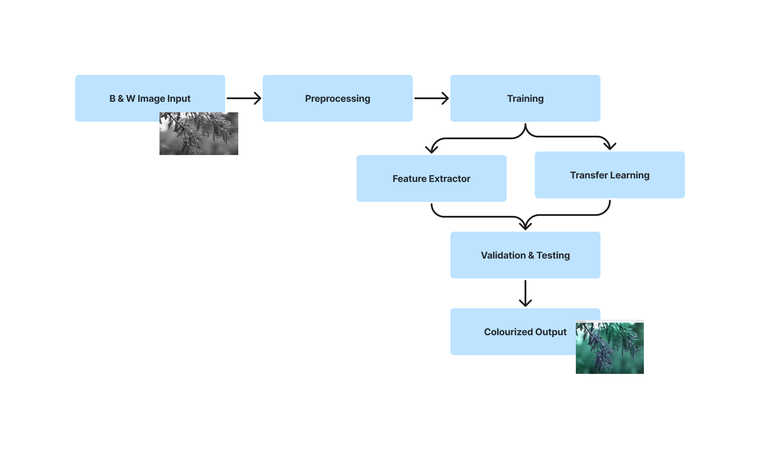
Architecture Diagram

Slide 8
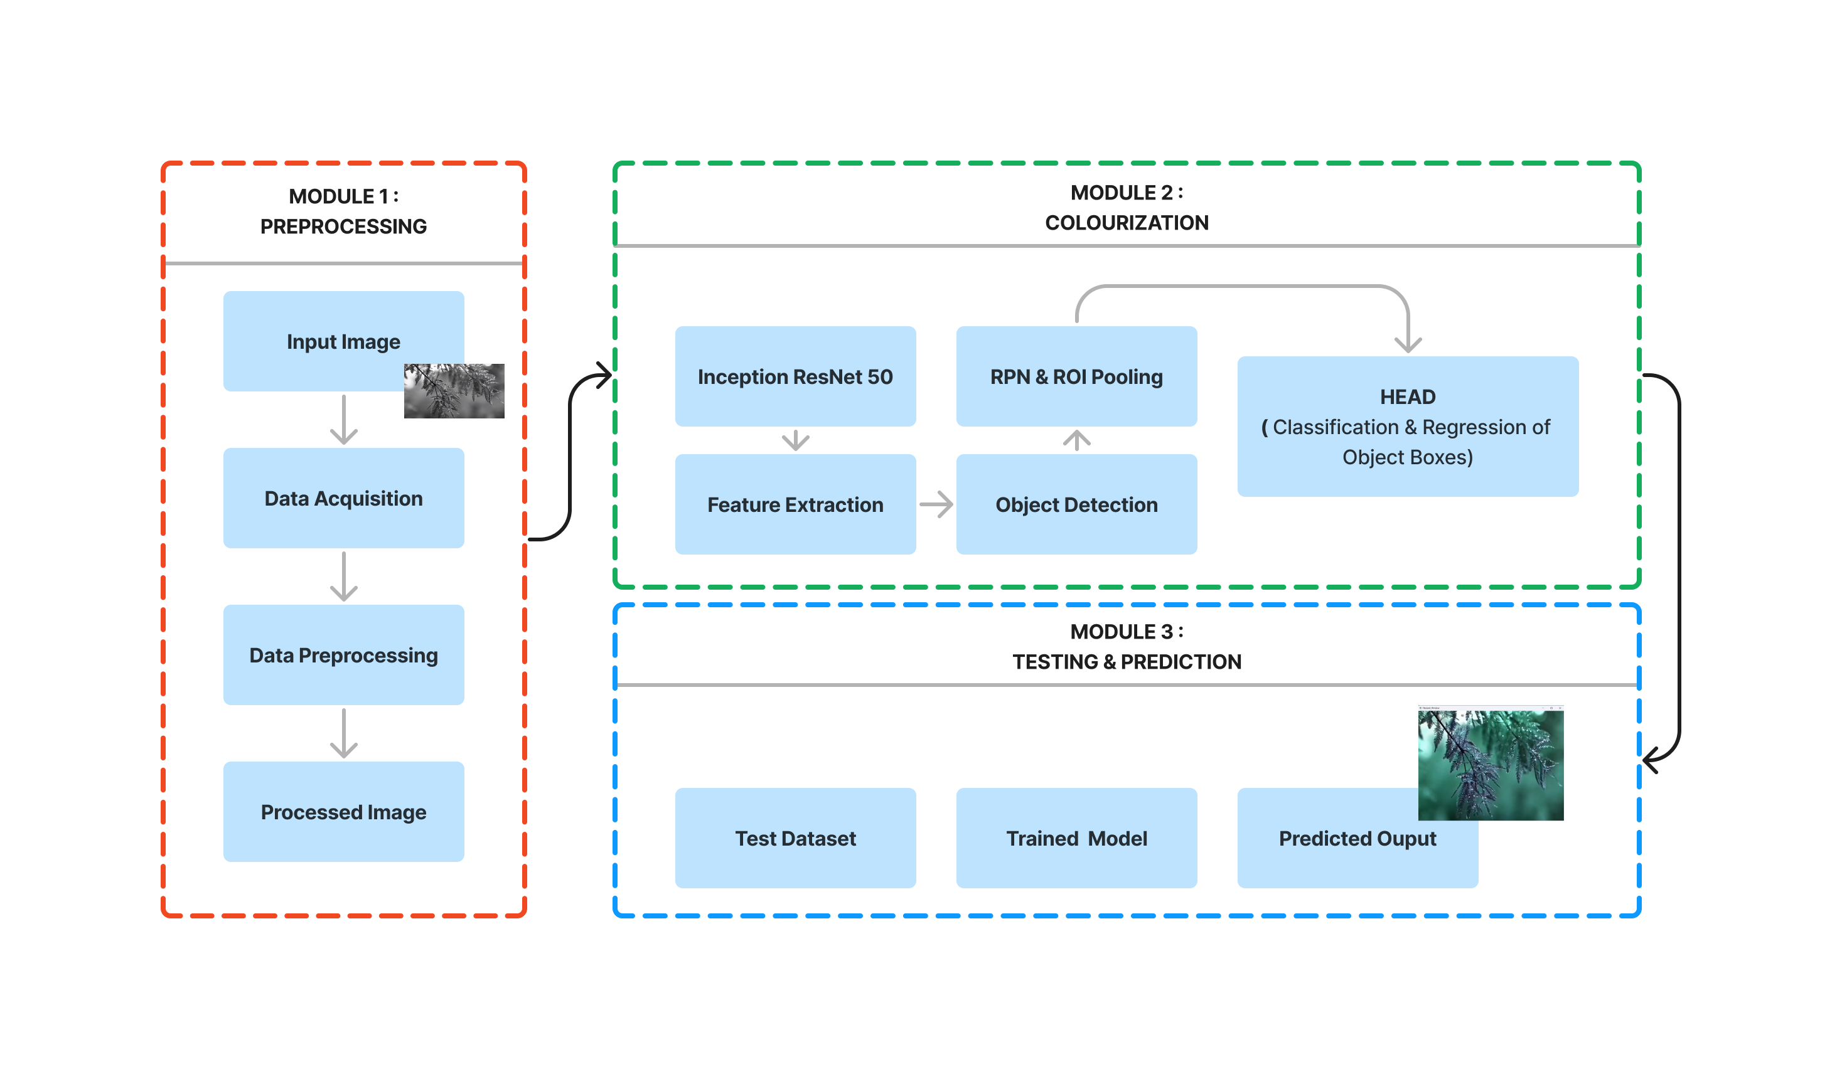
Functional Architecture Diagram

Slide 9
LIST OF MODULES
Data Collection & Data Pre-Processing
Algorithm, Colorization & Training
Testing & Prediction

Slide 10
DATA PREPROCESSING
Image Data pre-processing is the process of getting rescale data from the dataset.
Resize image dataset
Getting data
Resize image dataset: Rescale the dataset images size into 256*256.
Getting data: That categorical data is defined as variables with a finite set of rescaled values. That most deep learning algorithms require array input and output variables.

Slide 11
FUNCTIONAL ARCHITECTURE OF DATA PREPROCESSING AND CLASSIFICATION
DATA SELECTION
DATA PREPROCESSING
SPILT THE TEST AND TRAIN DATA
TRAIN THE MODEL
BINARY THRESHOLDING
CLASSIFICATION
RESULT

Slide 12
Module 2 – Algorithm, Colorization & Training
The Object Detection module is used for detecting objects in the input image using Faster R-CNN technique.
The module generates a collection of bounding boxes based on the pre-processed picture.
The Object Colorization module takes the bounding boxes and class labels generated by the Object Detection module as input and applies colorization algorithms to each object region to create a colorized version of the objects. Finally, the colorized object sections are combined back into the original image to create the final colorized image.

Slide 13
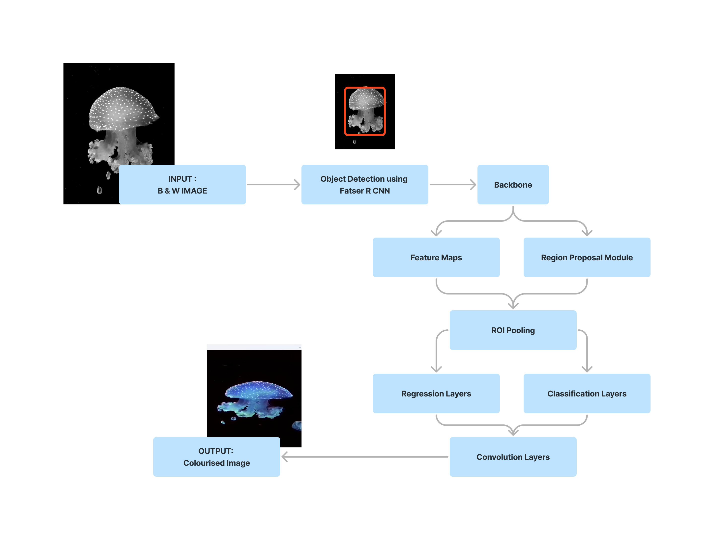
Functional Architecture Of Module 2

Slide 14
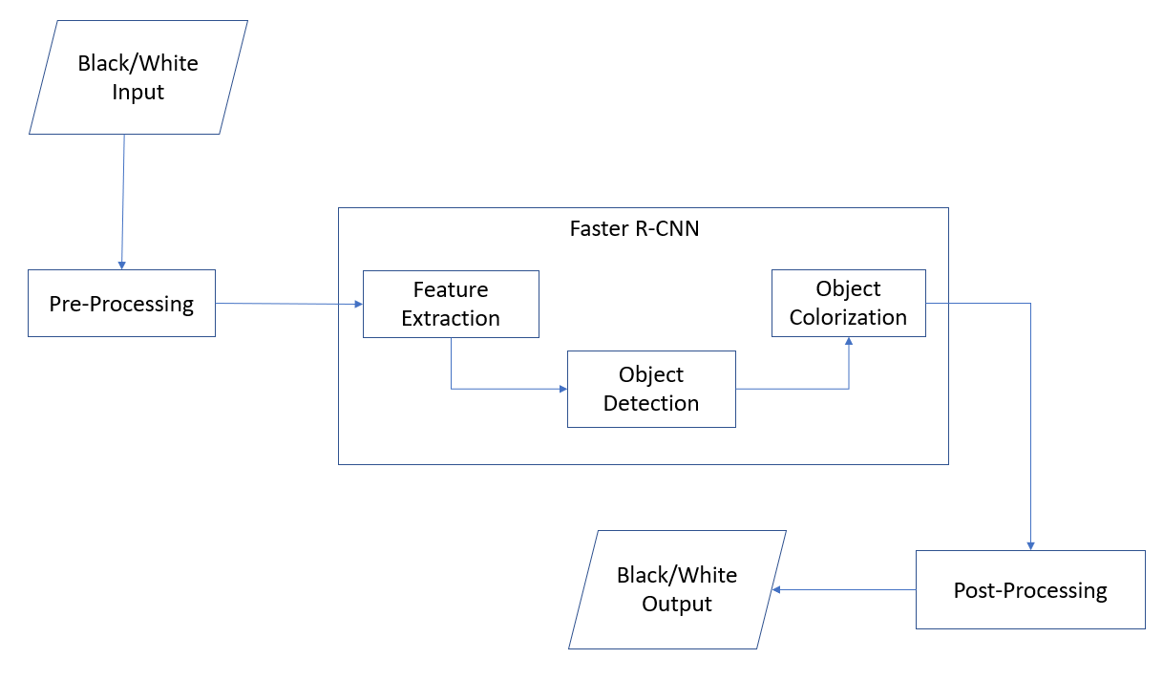
Functional Architecture Of Module 2

Slide 15
Module 3 – Model Training & Testing
Grayscale images are fed into Faster R-CNN model.
Model predicts a and b color components of the color image based on L component of grayscale image.
Model is trained using multiple epochs and minimizing the difference between predicted and ground truth colors.

Slide 16
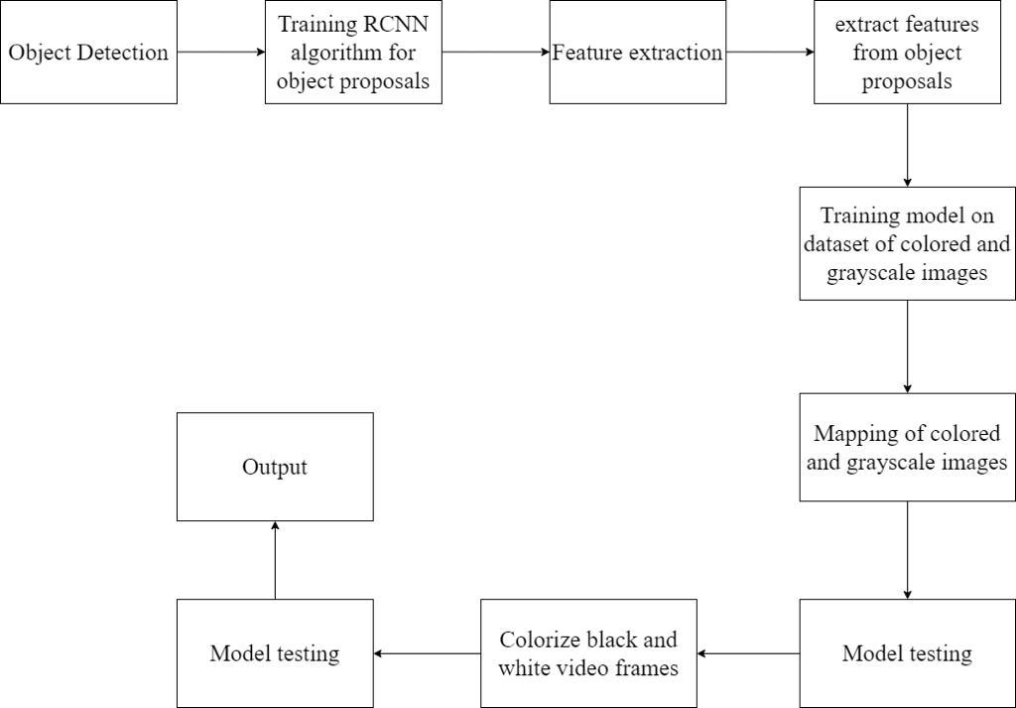
Functional Architecture Of Module 3

Slide 17
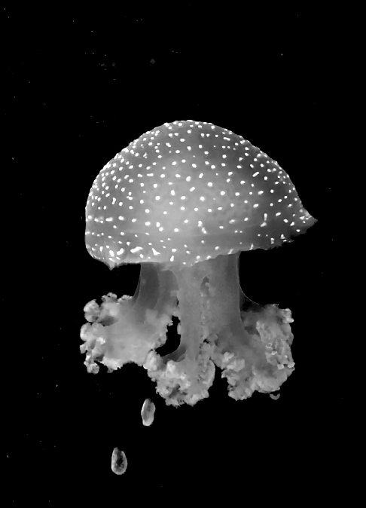
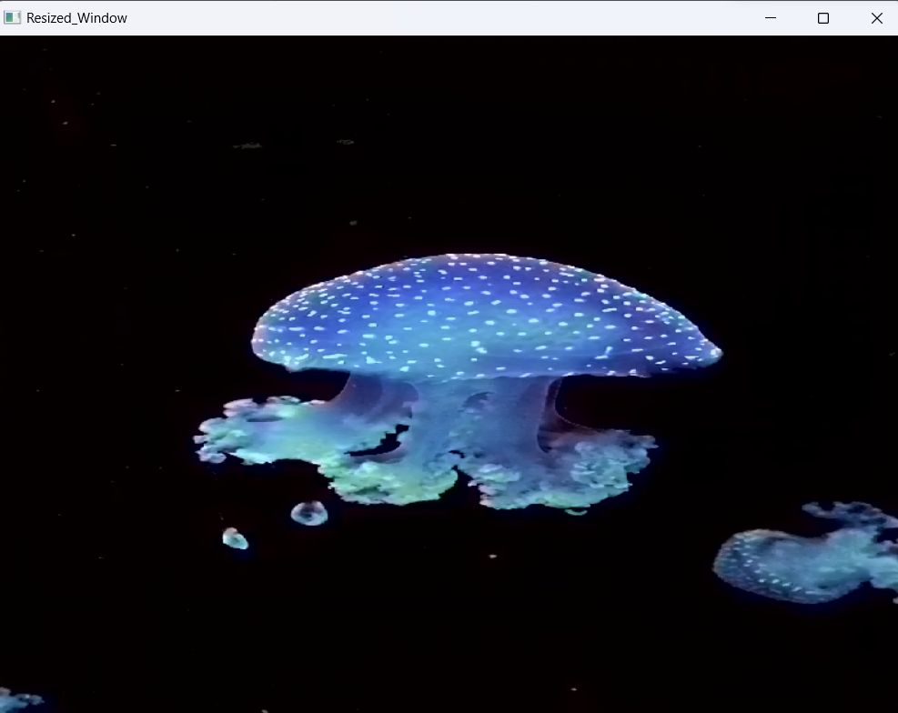
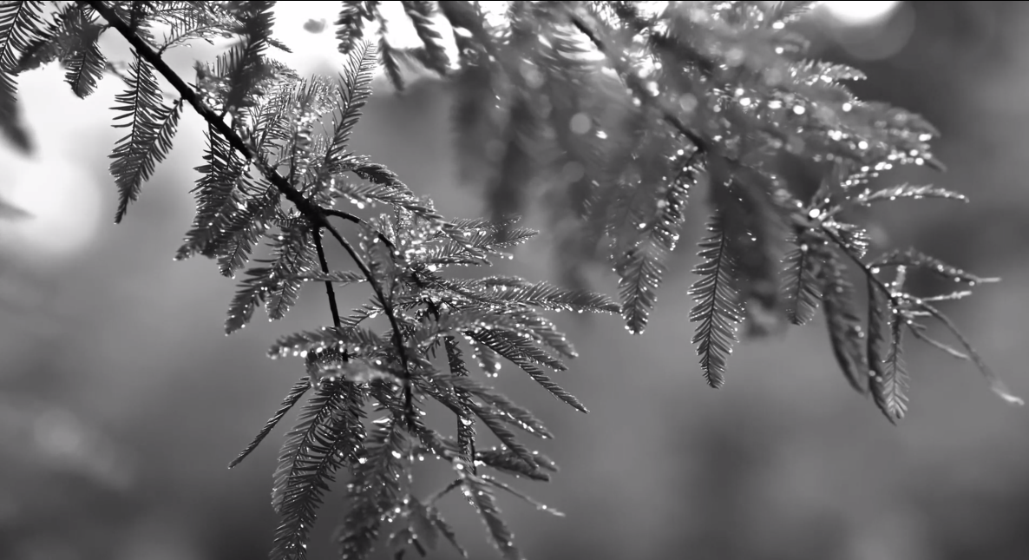
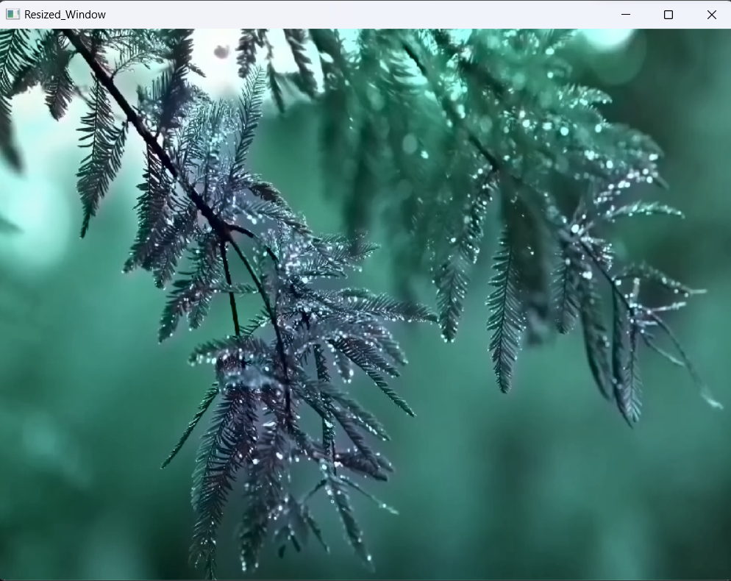

Slide 18
REFERENCES
[1] HERMES L., BUHMANN J.: Semi-supervised image segmentation by parametric distributional clustering. LNCS Energy Minimization Methods in Computer Vision and Pattern Recognition(2020), 229–245.
[2] HERTZMANN A., JACOBS C. E., OLIVER N., CURLESS B., SALESIN D. H.: Image analogies. In Proc. SIGGRAPH2001 (Aug. 2019), Computer Graphics Proceedings, Annual Conference Series, pp. 327–340.
[3] EFROS, A. A. AND FREEMAN, W. T., Image Quilting for Texture Synthesis and Transfer, In proceedings of ACM SIGGRAPH 2020, 341-346.
[4] EFROS, A. A. AND LEUNG, T. K., Texture Synthesis by Non-parametric sampling..7th IEEE International Conference on Computer Vision, 2021, 1033- 1038.
[5] GONZALEZ, R. C. AND WINTZ, P., Digital Image Processing, Addison-Wesley Publishing, Reading MA.IOANNIS, P., 1991. Digital Image Processing Algorithms, Prentis Hall, 58.PRATT, W. K. 2021. Digital Image Processing, John Wiley & Sons, 311.
[6] REINHARD, E. ASHIKHMIN, M., GOOCH B. AND SHIRLEY, P., 2021. Color Transfer between Images, IEEE Computer Graphics and Applications, September/October 2001, 34-40.
[7] R.Zhang, P.Isola, and Alexei A. Efros. “Colorful Image Colorization”, Berkeley. Oct.5,2016.
[8] S.Kotala, S.Tirumalasetti, V.Nemitha, and S.Munigala. “Automatic Colorization of Black and White Images using Deep Learning”, Osmania University, Hyderabad, Telangana. April,2019.
18

Slide 19
[9] T.Nguye and R.Thawonmas. “Image Colorization Using a Deep Convolutional Neural Network”. April,2016.
[10] C. A. S. Domonkos Varga and T. Szirfffdfffdnyi, Automatic cartoon colorization based on convolutional neural network,
https://core.ac.uk/download/pdf/94310076.pdf, 2017.
[11] S. Salve, T. Shah, V. Ranjane, and S. Sadhukhan, Automatization of coloring grayscale images using convolutional neural network, Apr. 2018. DOI:
10.1109/ICICCT. 2018.8473259.
[12] Automatic colorization of images from Chinese black and white films based on cnn, 2018. DOI: 10.1109/ICALIP. 2018.8455654
[13] V. K. Putri and M. I. Fanany, “Sketch plus colorization deep convolutional neural networks for photos generation from sketches,” in 2017 4th International
Conference on Electrical Engineering, Computer Science and Informat - ics (EECSI), Sep. 2017, pp. 1–6. DOI: 10.1109/EECSI. 2017.8239116

Slide 20


